Slide 1
General Register Organization

Slide 2
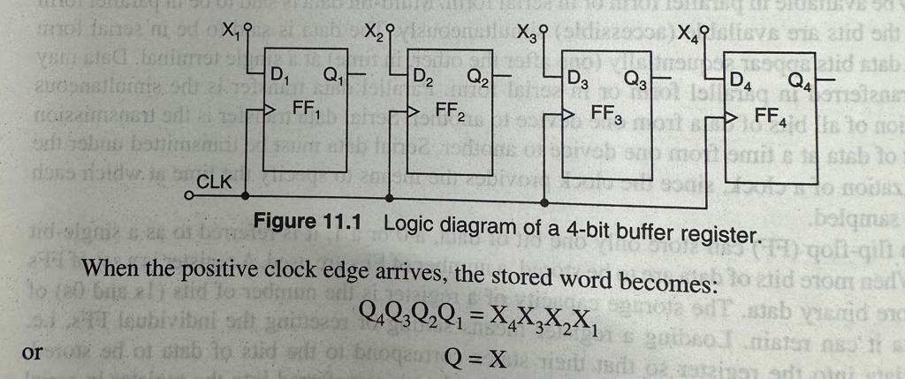
4 Bit Buffer Register using D Flip Flop

Slide 3
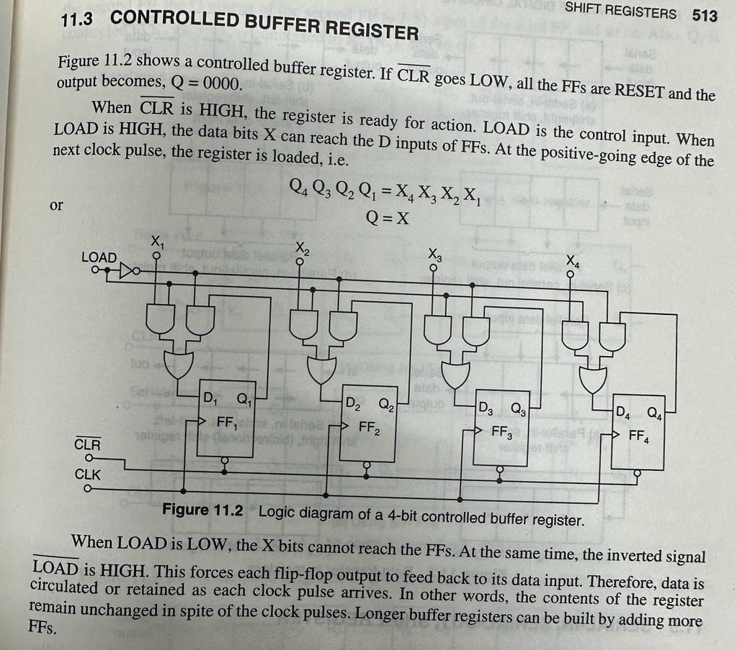
Controlled Buffer Register

Slide 4
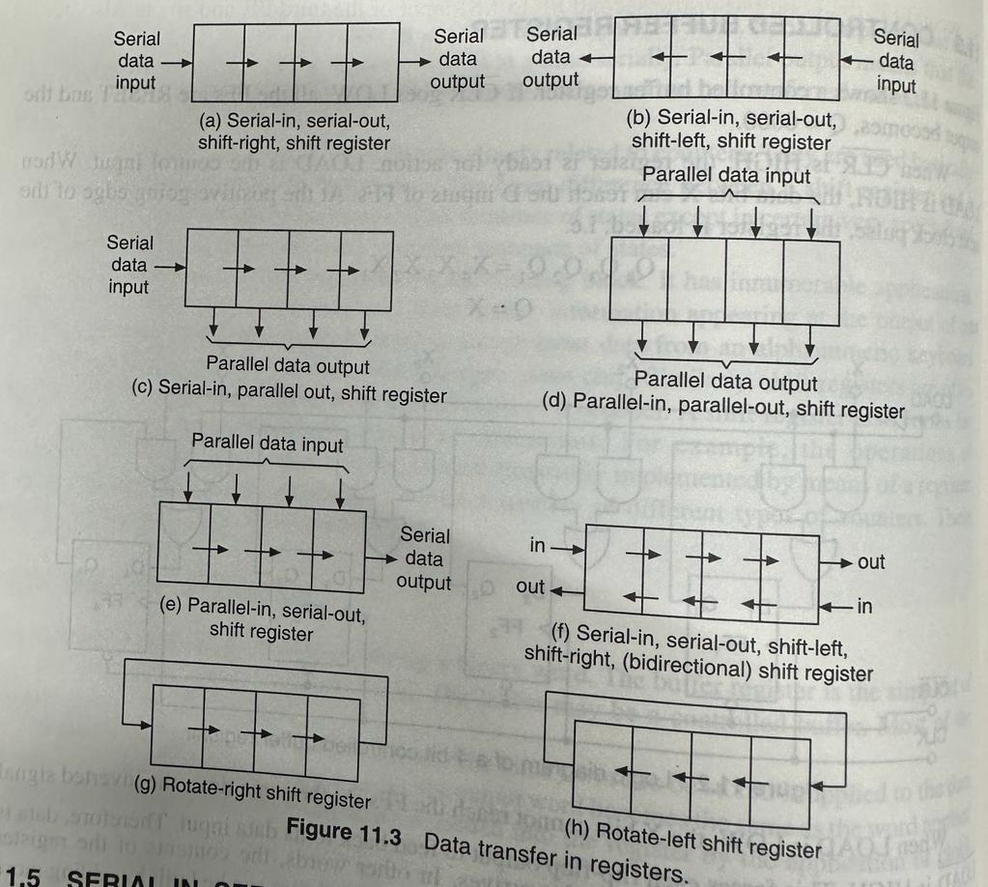
Serial and parallel arrangements in registers

Slide 5
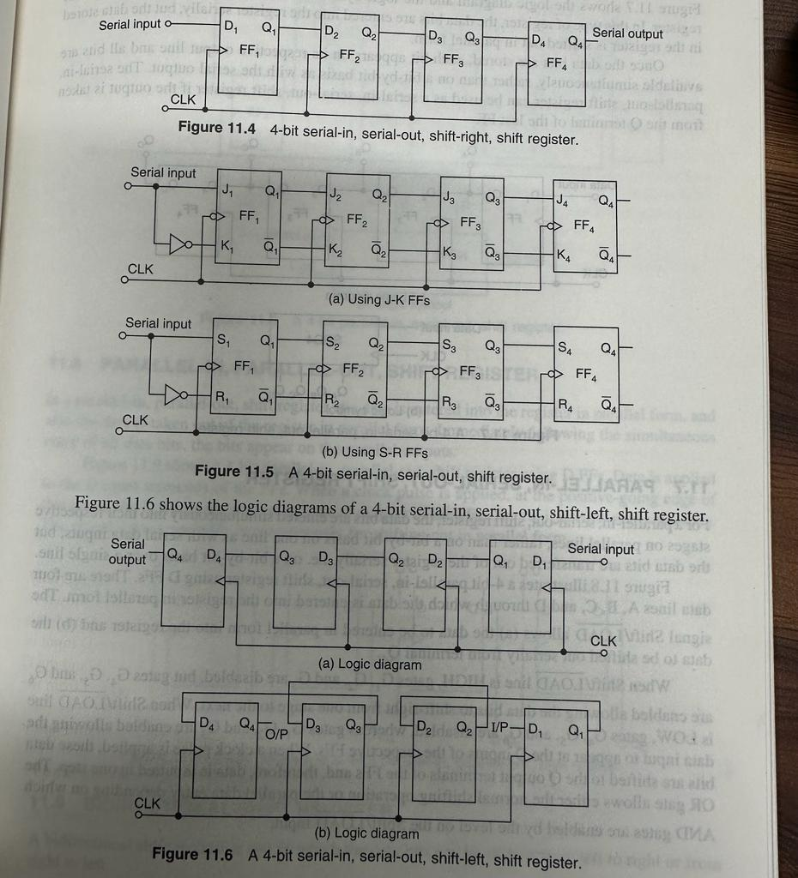
4 bit Shift Left and Shift Right Registers

Slide 6
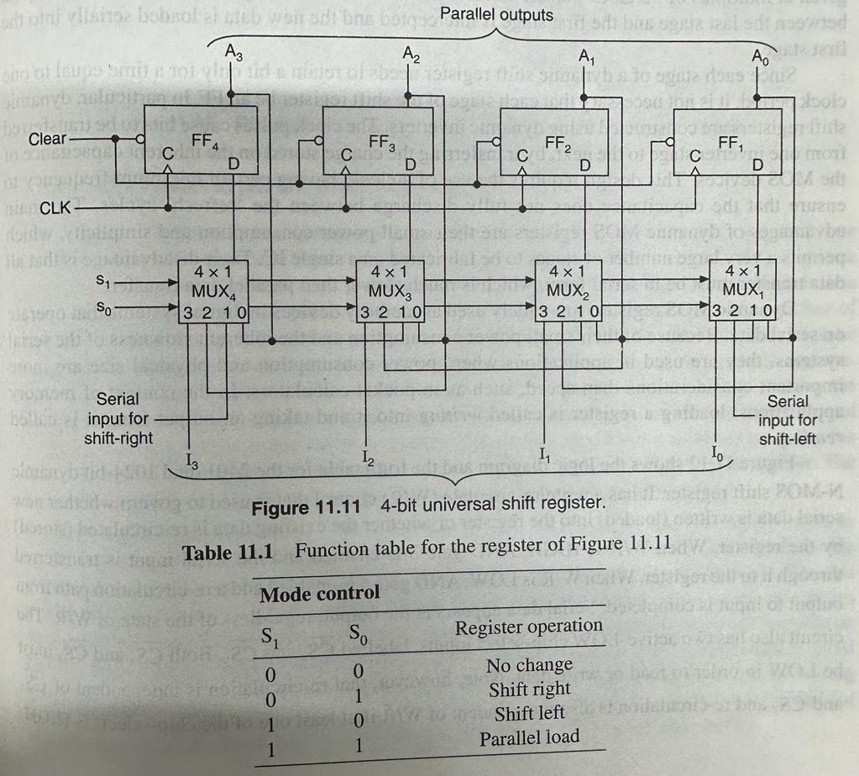
4 bit Universal Shift Register

Slide 7
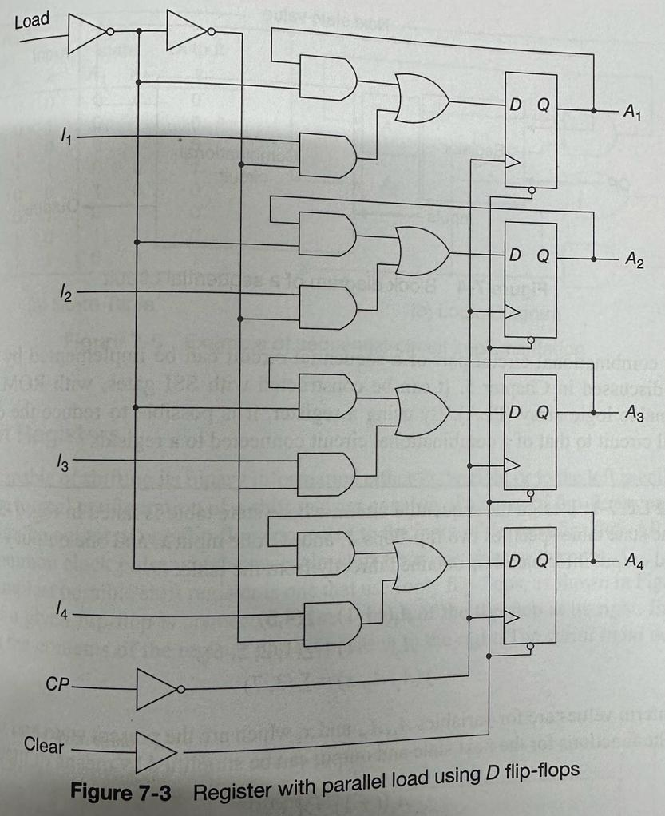
4 bit register with Parallel load using D F/F

Slide 8
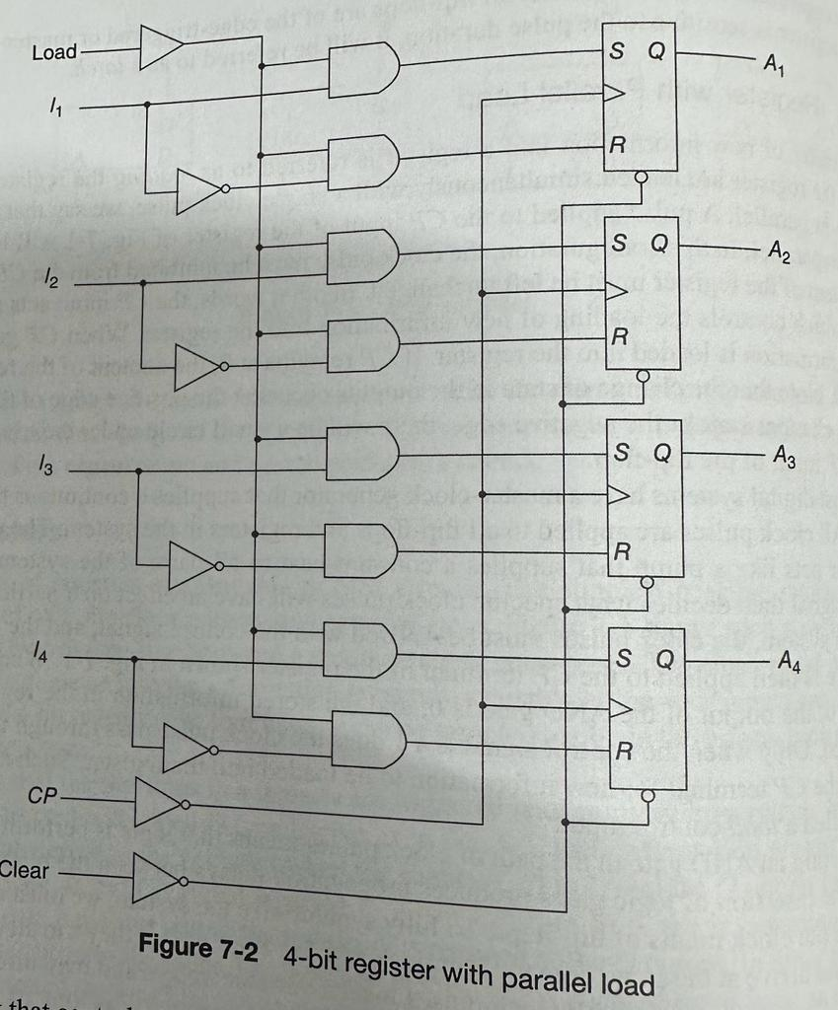
4 bit register with Parallel load using S-R F/F

Slide 9
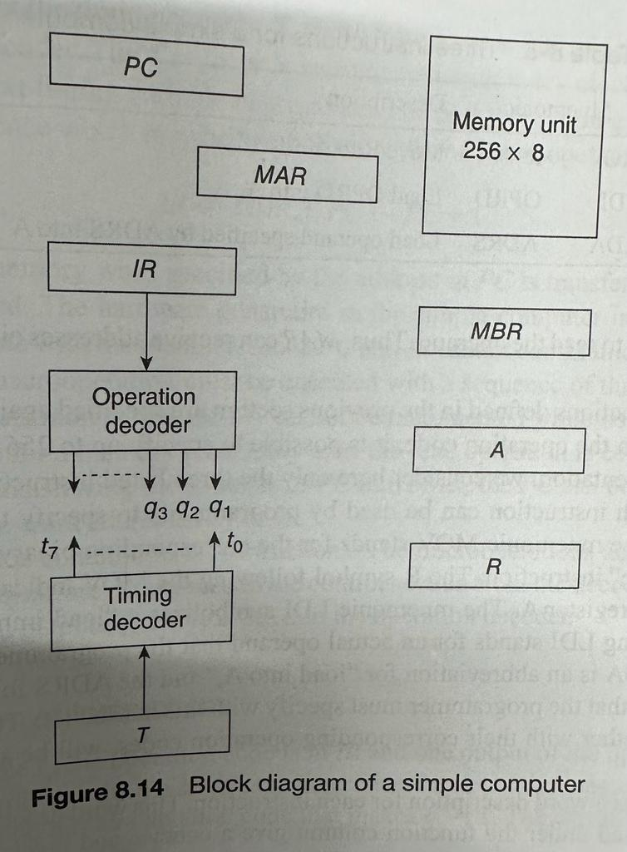
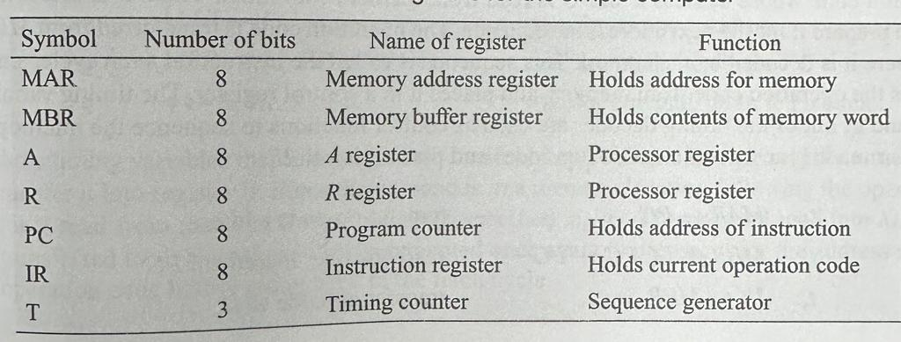
Block Diagram of Simple Computer

Slide 10
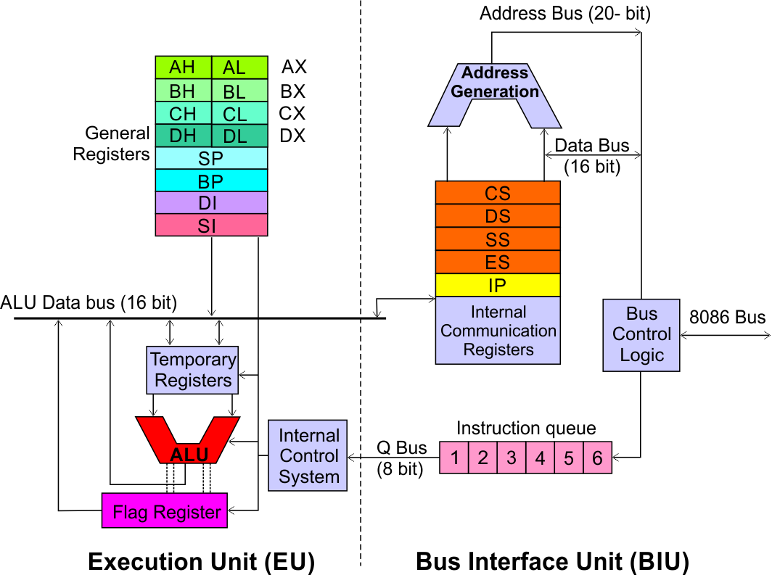
Register Organization of 8086 Microprocessor
Execution Unit (EU)
EU executes instructions that have already been fetched by the BIU.
BIU and EU functions separately.
Bus Interface Unit (BIU)
BIU fetches instructions, reads data from memory and I/O ports, writes data to memory and I/ O ports.

Slide 11
Register Organization
Bus Interface Unit (BIU)
Dedicated to generate 20 bit address
Four 16-bit segment registers
Code Segment (CS)
Data Segment (DS)
Stack Segment (SS)
Extra Segment (ES)
Segment Registers >>

Slide 12
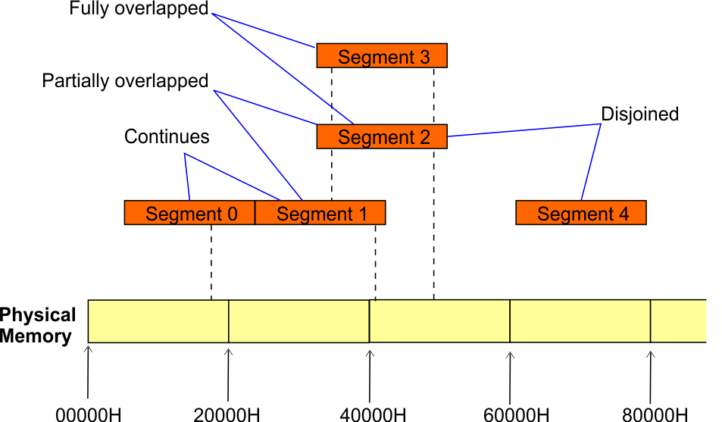
Register Organization
Bus Interface Unit (BIU)
Segment
Registers
1 MB memory of an 8086 Microprocessor is divided into segments of size up to 64KB each.
At any particular time, the 8086 can directly address four segments (256 KB within the 1 MB of memory).
Programs obtain access to code and data in the segments by changing the segment register content to point to the desired segments.

Slide 13
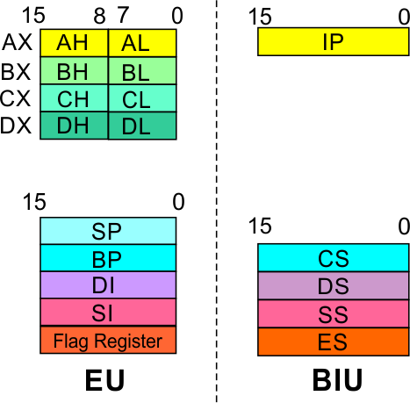
Register Organization
Bus Interface Unit (BIU)
Segment
Registers
Code Segment Register
16-bit
CS contains the base or start of the current code segment; IP (Instruction pointer) contains the distance or offset from this address to the next instruction byte to be fetched.
BIU computes the 20-bit physical address by logically shifting the contents of CS 4-bits to the left and then adding the 16-bit contents of IP.
That is, all instructions of a program are relative to the contents of the CS register multiplied by 16 and then offset is added provided by the IP.

Slide 14
Register Organization
Bus Interface Unit (BIU)
Segment
Registers
Data Segment Register
16-bit
Points to the current data segment; operands for most instructions are fetched from this segment.
The 16-bit contents of the Source Index (SI) or Destination Index (DI) or a 16-bit displacement are used as offset for computing the 20-bit physical address.

Slide 15
Register Organization
Bus Interface Unit (BIU)
Segment
Registers
Stack Segment Register
16-bit
Points to the current stack.
The 20-bit physical stack address is calculated from the Stack Segment (SS) and the Stack Pointer (SP) for stack instructions such as PUSH and POP.
In based addressing mode, the 20-bit physical stack address is calculated from the Stack segment (SS) and the Base Pointer (BP).

Slide 16
Register Organization
Bus Interface Unit (BIU)
Segment
Registers
Extra Segment Register
16-bit
Points to the extra segment in which data (in excess of 64K pointed to by the DS) is stored.
String instructions use the ES and DI to determine the 20-bit physical address for the destination.

Slide 17
Register Organization
Bus Interface Unit (BIU)
Segment
Registers
Instruction Pointer
16-bit
Always points to the next instruction to be executed within the currently executing code segment.
So, this register contains the 16-bit offset address pointing to the next instruction code within the 64Kb of the code segment area.
Its content is automatically incremented as the execution of the next instruction takes place.

Slide 18
Register Organization
Bus Interface Unit (BIU)
Instruction queue
A group of First-In-First-Out (FIFO) in which up to 6 bytes of instruction code are pre fetched from the memory ahead of time.
This is done in order to speed up the execution by overlapping instruction fetch with execution.
This mechanism is known as pipelining.

Slide 19
Register Organization
EU decodes and executes instructions.
A decoder in the EU control system translates instructions.
Execution Unit (EU)
16-bit ALU for performing arithmetic and logic operation
Four general purpose registers(AX, BX, CX, DX);
Pointer registers (Stack Pointer, Base Pointer);
and
Index registers (Source Index, Destination Index) each of 16-bits
Some of the 16 bit registers can be used as two 8 bit registers as :
AX can be used as AH and AL
BX can be used as BH and BL
CX can be used as CH and CL
DX can be used as DH and DL

Slide 20
Register Organization
Execution Unit (EU)
EU
Registers
Accumulator Register (AX)
Consists of two 8-bit registers AL and AH, which can be combined together and used as a 16-bit register AX.
AL in this case contains the low order byte of the word, and AH contains the high-order byte.
The I/O instructions use the AX or AL for inputting / outputting 16 or 8 bit data to or from an I/O port.
Multiplication and Division instructions also use the AX or AL.

Slide 21
Register Organization
Execution Unit (EU)
EU
Registers
Base Register (BX)
Consists of two 8-bit registers BL and BH, which can be combined together and used as a 16-bit register BX.
BL in this case contains the low-order byte of the word, and BH contains the high-order byte.
This is the only general purpose register whose contents can be used for addressing the 8086 memory.
All memory references utilizing this register content for addressing use DS as the default segment register.

Slide 22
Register Organization
Execution Unit (EU)
EU
Registers
Counter Register (CX)
Consists of two 8-bit registers CL and CH, which can be combined together and used as a 16-bit register CX.
When combined, CL register contains the low order byte of the word, and CH contains the high-order byte.
Instructions such as SHIFT, ROTATE and LOOP use the contents of CX as a counter.
Example:
The instruction LOOP START automatically decrements CX by 1 without affecting flags and will check if [CX] = 0.
If it is zero, 8086 executes the next instruction; otherwise the 8086 branches to the label START.

Slide 23
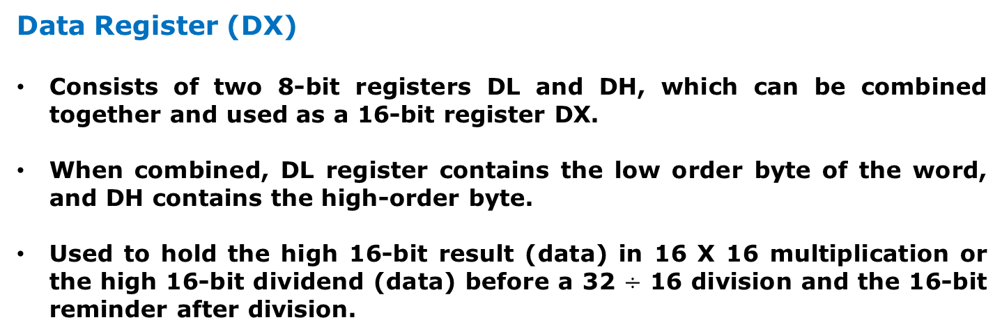
Register Organization
Execution Unit (EU)
EU
Registers
Data Register (DX)
Consists of two 8-bit registers DL and DH, which can be combined together and used as a 16-bit register DX.
When combined, DL register contains the low order byte of the word, and DH contains the high-order byte.
Used to hold the high 16-bit result (data) in 16 X 16 multiplication or the high 16-bit dividend (data) before a 32 $÷$ 16 division and the 16-bit reminder after division.

Slide 24
Register Organization
Execution Unit (EU)
EU
Registers
Stack Pointer (SP) and Base Pointer (BP)
SP and BP are used to access data in the stack segment.
SP is used as an offset from the current SS during execution of instructions that involve the stack segment in the external memory.
SP contents are automatically updated (incremented/ decremented) due to execution of a POP or PUSH instruction.
BP contains an offset address in the current SS, which is used by instructions utilizing the based addressing mode.

Slide 25
Register Organization
Execution Unit (EU)
EU
Registers
Source Index (SI) and Destination Index (DI)
Used in indexed addressing.
Instructions that process data strings use the SI and DI registers together with DS and ES respectively in order to distinguish between the source and destination addresses.

Slide 26
Register Organization
Execution Unit (EU)
Flag Register
Parity Flag
This flag is set to 1, if the lower byte of the result contains even number of 1’s ; for odd number of 1’s set to zero.
Auxiliary Carry Flag
This is set, if there is a carry from the lowest nibble, i.e, bit three during addition, or borrow for the lowest nibble, i.e, bit three, during subtraction.
Carry Flag
This flag is set, when there is a carry out of MSB in case of addition or a borrow in case of subtraction.
Zero Flag
This flag is set, if the result of the computation or comparison performed by an instruction is zero
Sign Flag
This flag is set, when the result of any computation is negative
15 | 14 | 13 | 12 | 11 | 10 | 9 | 8 | 7 | 6 | 5 | 4 | 3 | 2 | 1 | 0
 |  |  |  | OF | DF | IF | TF | SF | ZF |  | AF |  | PF |  | CF
Over flow Flag
This flag is set, if an overflow occurs, i.e, if the result of a signed operation is large enough to accommodate in a destination register. The result is of more than 7-bits in size in case of 8-bit signed operation and more than 15-bits in size in case of 16-bit sign operations, then the overflow will be set.
Trap Flag
If this flag is set, the processor enters the single step execution mode by generating internal interrupts after the execution of each instruction
Direction Flag
This is used by string manipulation instructions. If this flag bit is ‘0’, the string is processed beginning from the lowest address to the highest address, i.e., auto incrementing mode. Otherwise, the string is processed from the highest address towards the lowest address, i.e., auto incrementing mode.
Interrupt Flag
Causes the 8086 to recognize external mask interrupts; clearing IF disables these interrupts.

Slide 27
Register Organization
Registers and Special Functions
Register | Name of the Register | Special Function
AX | 16-bit Accumulator | Stores the 16-bit results of arithmetic and logic operations
AL | 8-bit Accumulator | Stores the 8-bit results of arithmetic and logic operations
BX | Base register | Used to hold base value in base addressing mode to access memory data
CX | Count Register | Used to hold the count value in SHIFT, ROTATE and LOOP instructions
DX | Data Register | Used to hold data for multiplication and division operations
SP | Stack Pointer | Used to hold the offset address of top stack memory
BP | Base Pointer | Used to hold the base value in base addressing using SS register to access data from stack memory
SI | Source Index | Used to hold index value of source operand (data) for string instructions
DI | Data Index | Used to hold the index value of destination operand (data) for string operations

